Slide 1
QMST 5335
Module 3.1
Introduction to Simio and First Simio Models

Slide 2
Learning Objectives:
Understanding the basics of Simio to design a simulation model
Learning the basics of experimentation and analysis
Understanding the need for model verification

Slide 3
Outline
Basic Simio User Interface
First Simio Model
  Modeling : An M/M/1
  Verification: An M/M/1
A Review with an Example

Slide 4
Outline
Basic Simio User Interface
First Simio Model
  Modeling : An M/M/1
  Verification: An M/M/1
A Review with an Example

Slide 5
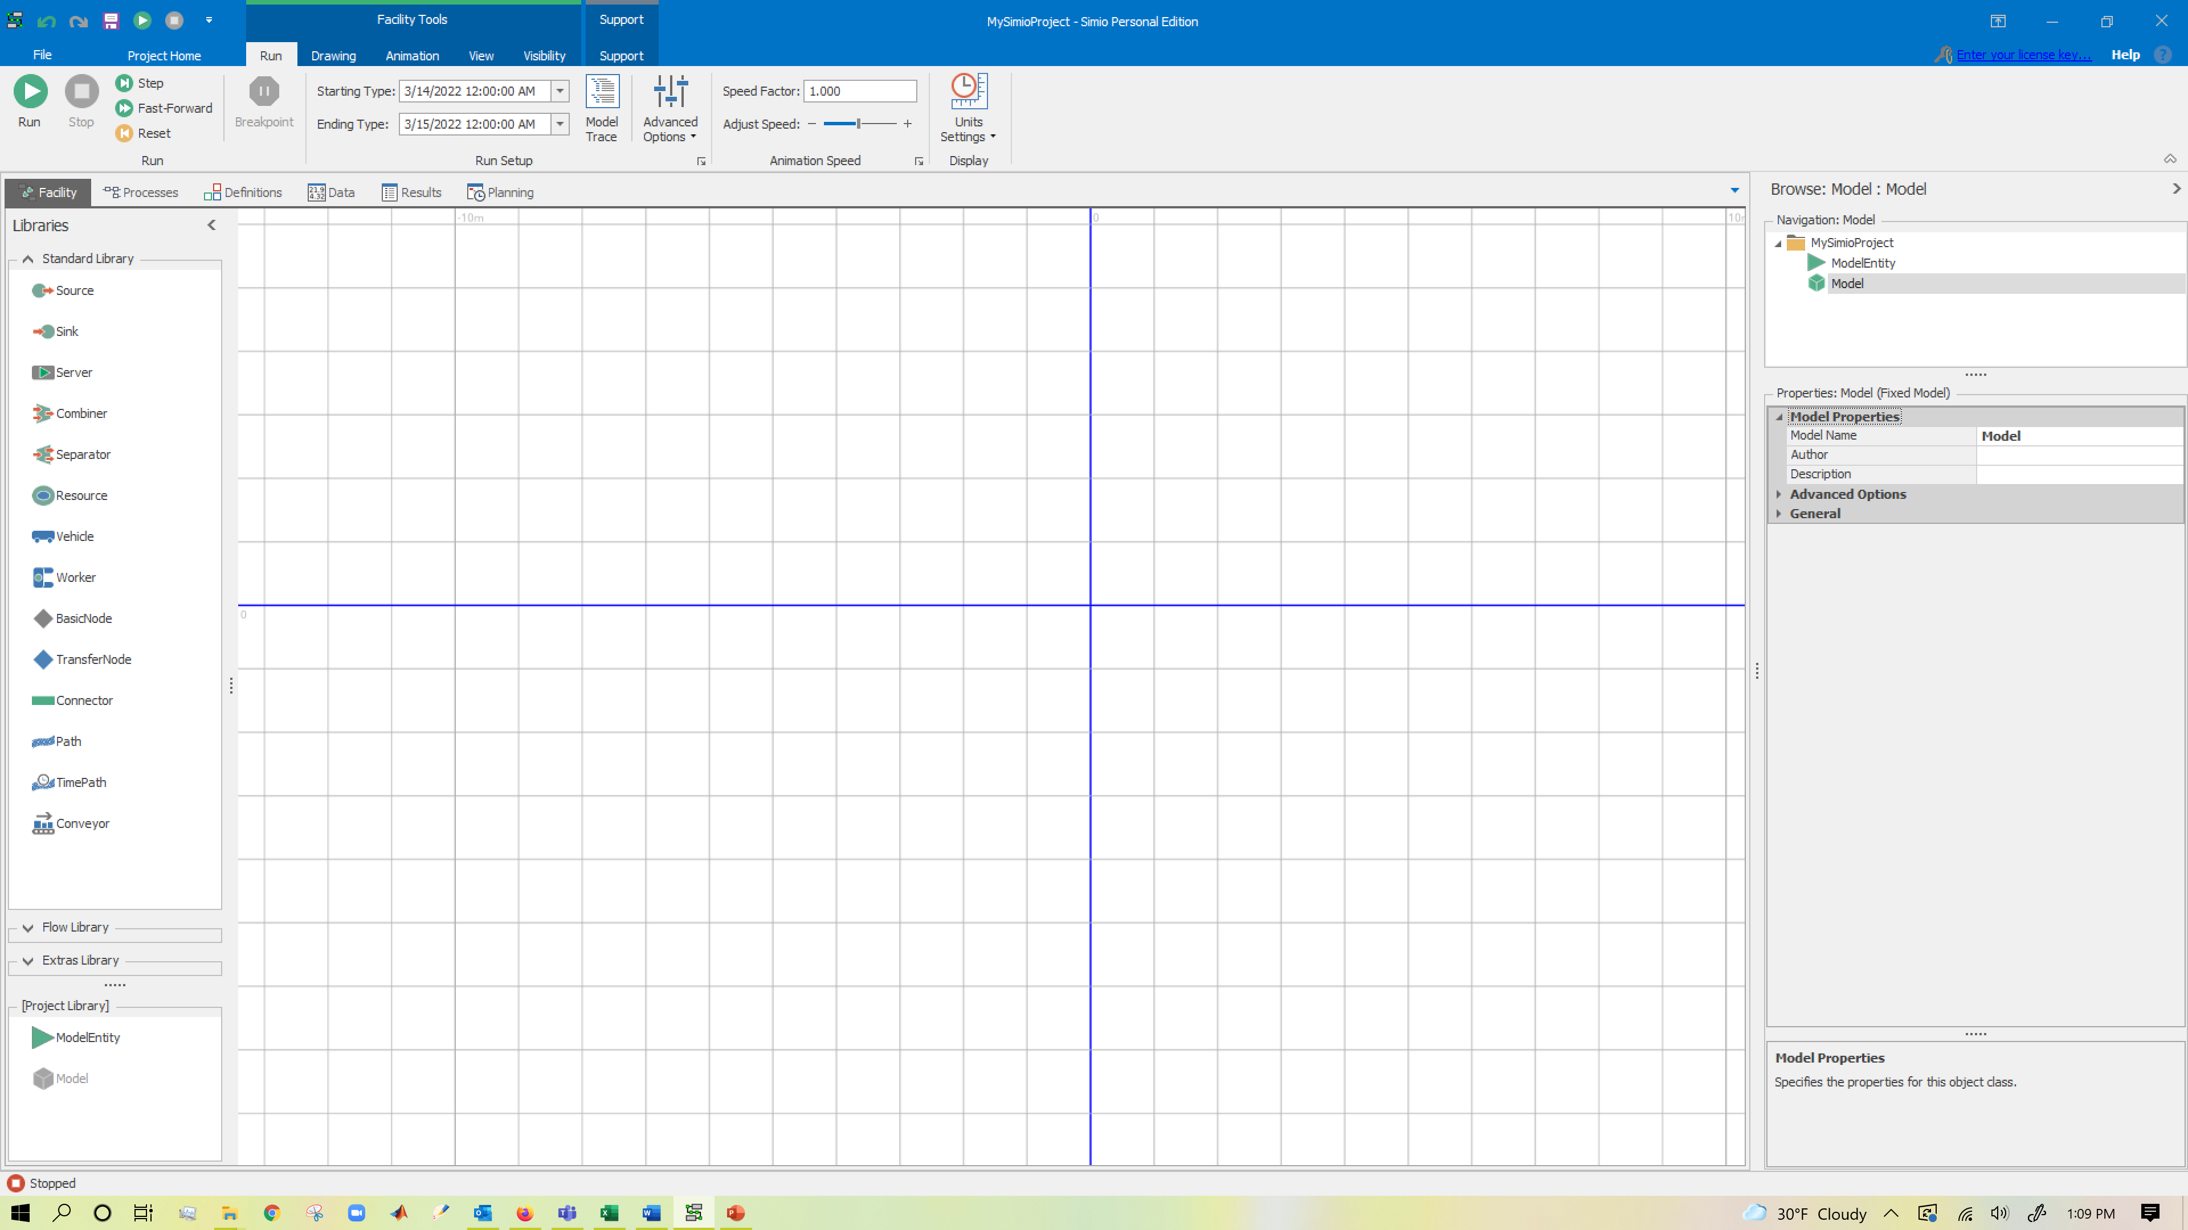
Basic Simio User Interface
When you load Simio, you will see the Facility View
Organized in ‘tabs’ and ‘ribbons’
→ What you see will depend on where you are

Slide 6
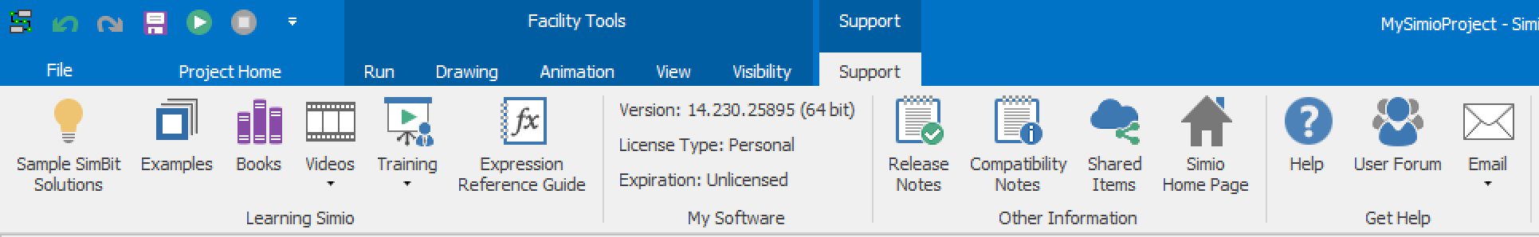
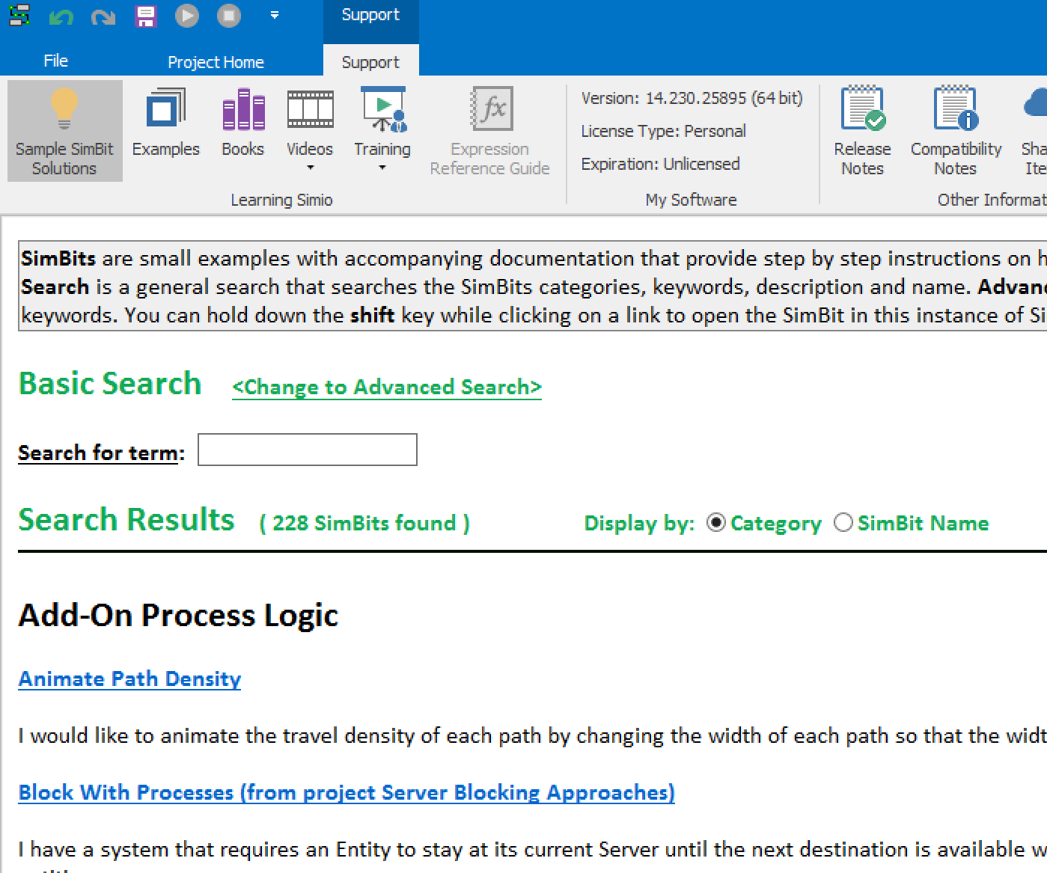
Basic Simio User Interface
Support Ribbon
  Multiple Video Sets and hundreds of YouTube videos
  Other Publications for reference
  SimBits
    Small examples for a concept
    comes with pdf and the simio model
    You can search SimBits

Slide 7
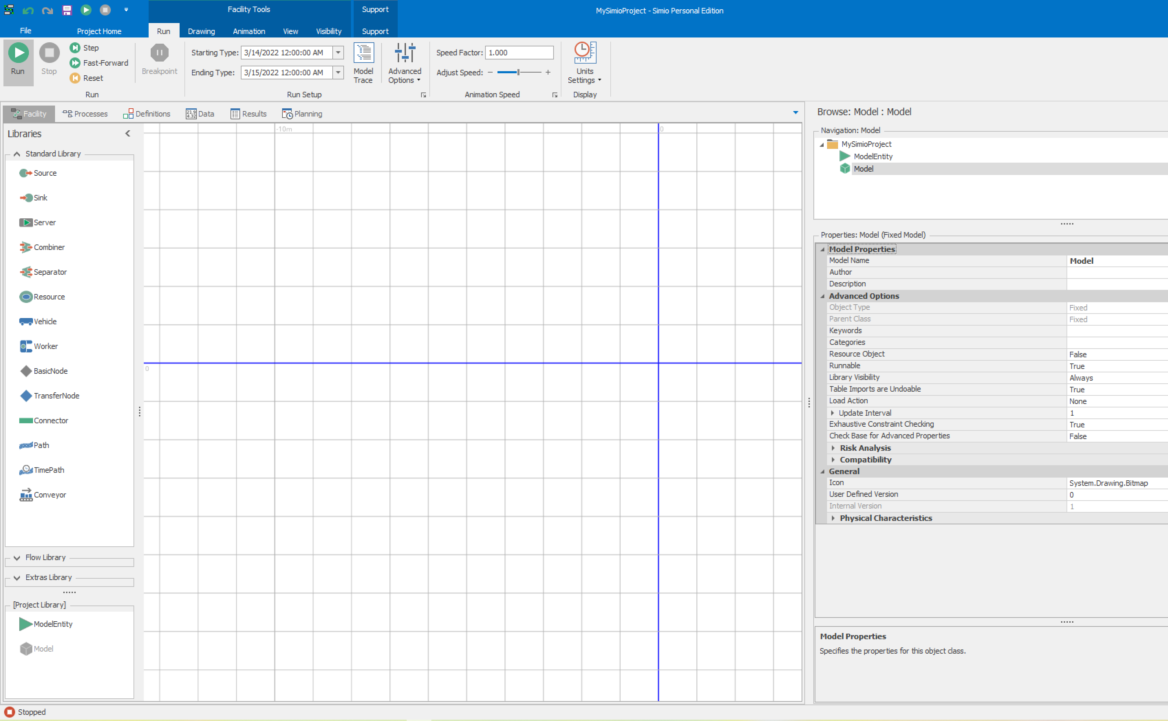
Basic Simio User Interface
User Interface
Files Menu
Ribbons
Project
Project Tabs
Current Model
Libraries
Facility View
Properties

Slide 8
Basic Simio User Interface
Key Simio concepts:
Object: | Defines data, logic, behavior, view, events, and interaction with other objects.
Model: | An object that is executable.
Project: | A collection of models/objects. A project can be loaded as a library.
Properties: | Static inputs to an object.
States: | Changeable values associated with an object
Events: | Supports communication between objects. Fired when key things happen.
Resource: | Constrains the system. Any object (even an entity) may be a resource.
Entity: | A dynamic object that may move through system
Transporter: | An entity that can “work on” or carry other entities. Vehicles and Workers are entities (and resources).

Slide 9
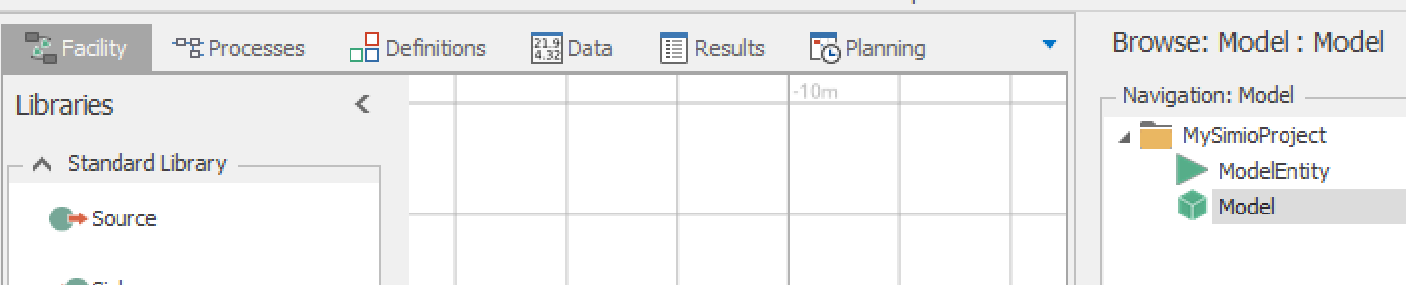
Basic Simio User Interface
Model windows:
  Facility window defines model logic in terms of animated objects.
  Processes window defines the model logic in terms of traditional process flow (not in Express Edition)
  Definitions window defines an object’s properties, states, events, lists and more.
  Data window allows you to access a number of panels to create and edit data.
  Results window displays the results in the form of a Pivot Grid or a Report
  Planning window displays the options to create schedules, workflows, etc.

Slide 10
Basic Simio User Interface
More on Model windows:
  Ribbons replace menus and toolbars and change dynamically based on what you are doing.
  Navigation window allows you to move between various models and other components of your project.
  Properties window lets you set the properties of an object to customize its behavior.
  Library displays the Standard Library, your Project Library, and other optional libraries.

Slide 11
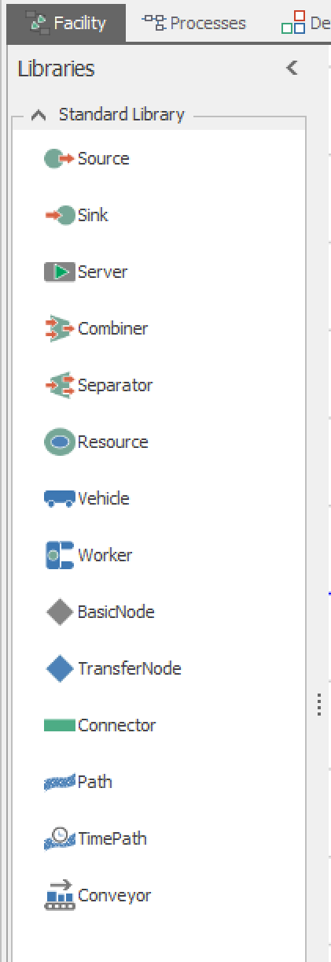
Basic Simio User Interface
Standard library:
Source: | Generate entities of a specified type and arrival pattern.
Sink: | Destroy entities.
Server: | Capacitated process, such as a machine.
Workstation: | Capacitated process, includes setup, process, tear-down.
Combiner: | Batches entities with a parent entity (e.g., pallet).
Separator: | Splits batches or copies entities.
Resource: | Seized/Released by objects.
Vehicle: | Fixed route or on-demand pickups/drop-offs.
Worker: | Moveable resource, for stationary and non-stationary tasks.
BasicNode: | Simple intersection, fixed object input.
TransferNode: | Change destination/get rides, fixed object output.
Connector: | Zero travel time.
Path: | Entities independently move at their own speeds.
TimePath: | Entities complete travel in a specified time.
Conveyor: | Accumulating/non-accumulating conveyor devices.

Slide 12
Basic Simio User Interface
Modeling paradigms:
  Objects
    Intuitive, Easy, Most commonly used
    Facility Window
  Processes
    Flexible and Efficient
    Processes Window
  User Code
    Very rarely used, Ultimate in flexibility
    Lightly covered in Chapter 10
  All three can be mixed in a single model
  Read Chapter 4.1
We will be using Objects based modeling mostly

Slide 13
Outline
Basic Simio User Interface
First Simio Model
  Modeling : An M/M/1
  Verification: An M/M/1
A Review with an Example

Slide 14
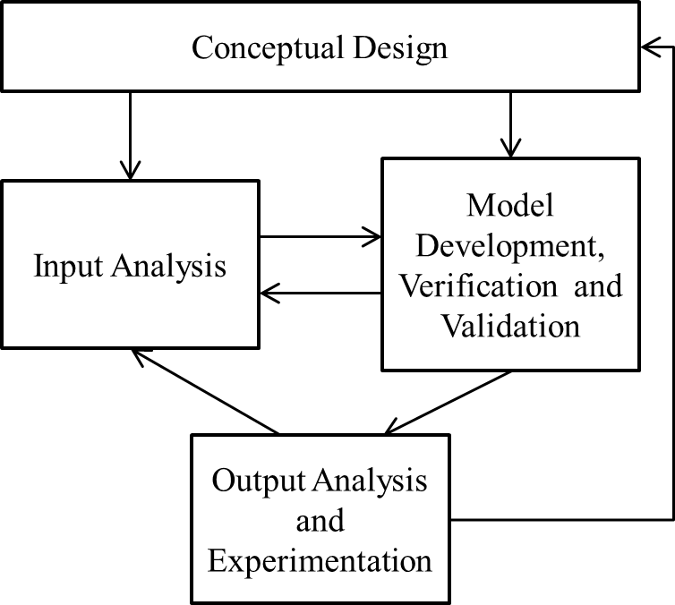
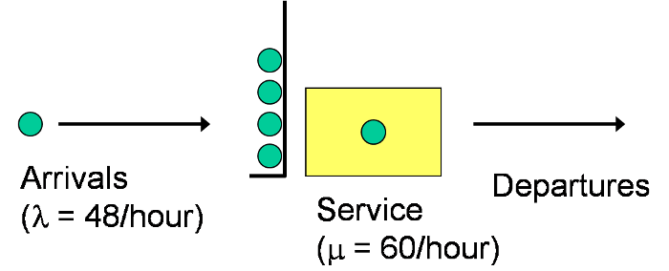
First Simio Model
Recall Simulation Process:
A single server queueing system
→Arrival rate is 48/hour
→Service rate is 60/hour
→ Both interarrival and service times are exponentially distributed
A single server queueing system
→Mean interarrival time: 1.25 minutes
→Mean service time: 1 minute

Slide 15
First Simio Model
Using Simio and some queueing theory, we will:
See ‘MM1.spfx’ file for the completed model.
Note: File extension .spfx is for Simio files.

Slide 16
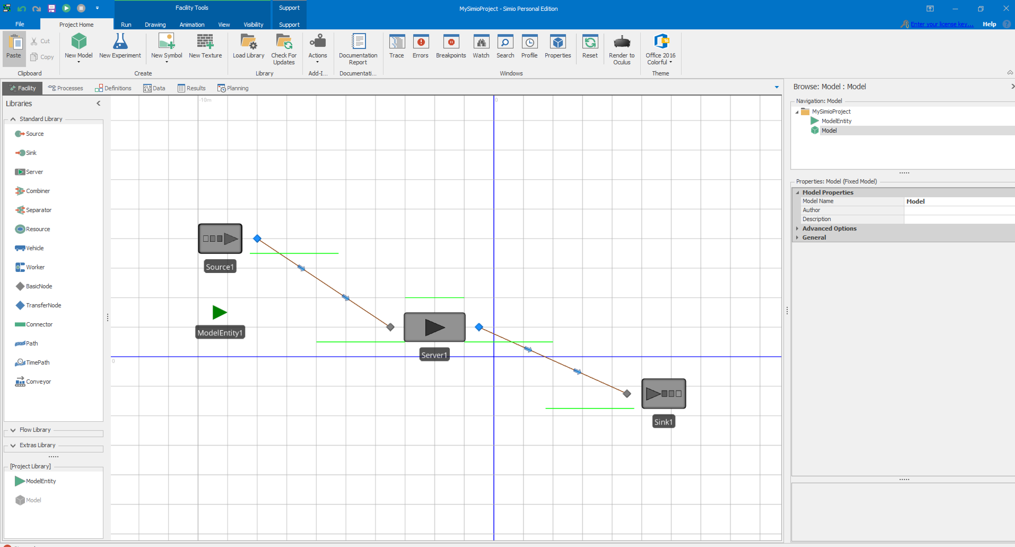
First Simio Model
Building the model:

Slide 17
First Simio Model
We have the model:

Slide 18
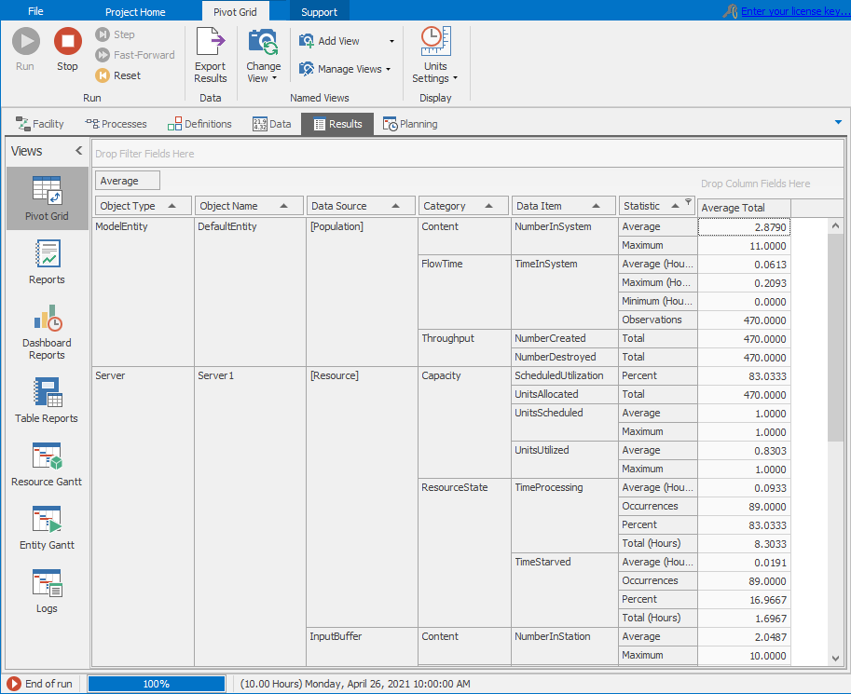
First Simio Model
Results: Pivot Table:
Manipulate, summarize, display, and explore your data.
Grouping: Drag columns to different positions to cause the data to be grouped differently.
Sorting: Click on triangle in column heading to toggle the column sort order between ascending and descending.
Filtering: Click on the funnel in column heading for a menu to enable/disable display of any field in that column.

Slide 19
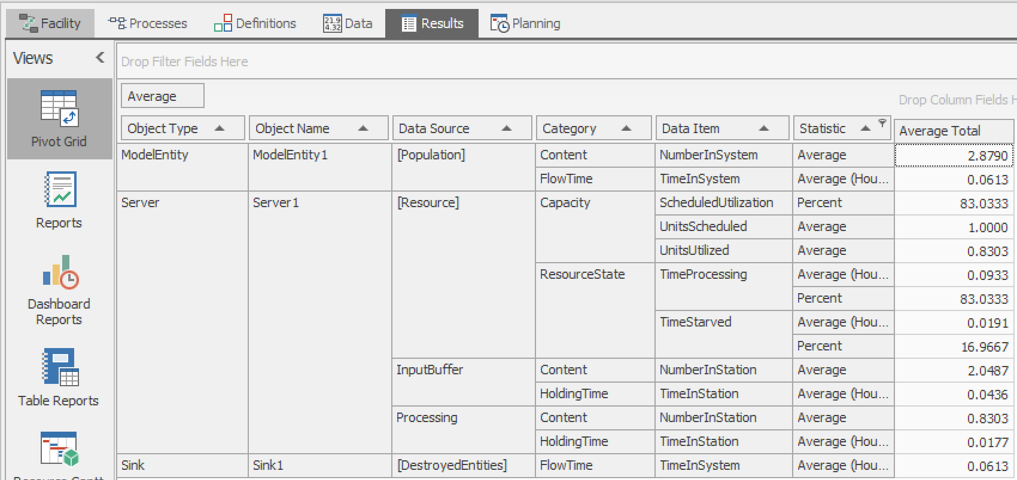
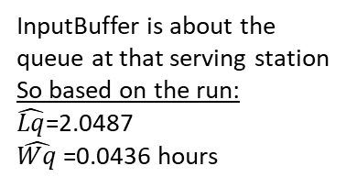
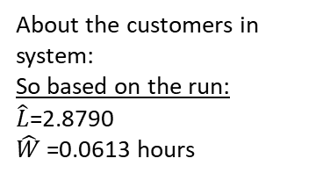

First Simio Model
Where are key performance measures?
About the customers in system:
So based on the run:
$\hat{L}$=2.8790
$\hat{W}$=0.0613 hours
Utilization is ρ
So based on the run:
$\hat{\text{ρ}}$=0.8303
InputBuffer is about the queue at that serving station
So based on the run:
$\hat{Lq}$=2.0487
$\hat{Wq}$=0.0436 hours

Slide 20
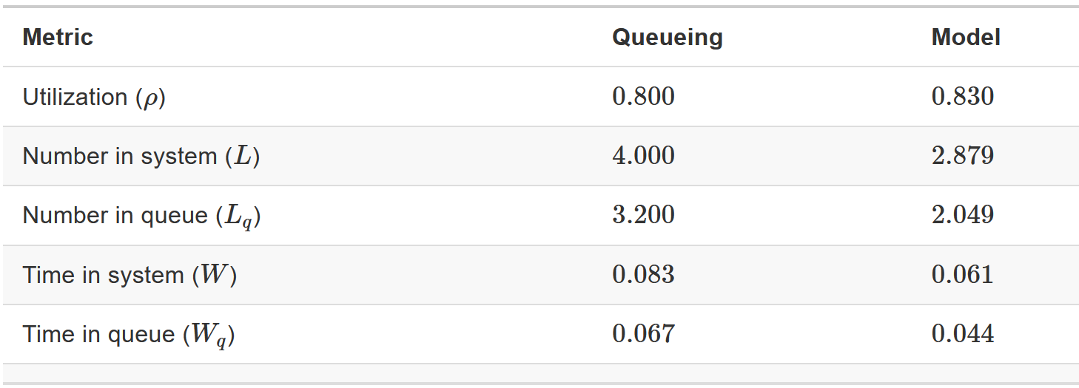
First Simio Model
Model verification:
  We know that the system we simulated is M/M/1
  We have theoretical results for the system: L, Lq, W, Wq
  We also have some results from the simulation model

Slide 21
First Simio Model
Model verification:
  Our simulation model results don’t match the queueing model results.
  Possible reasons why our model results will not match our expectations include:
    Our Simio model is wrong – i.e., we have an error somewhere in the model itself
      Not likely the case here because the system is quite simple
      We watch the simulation run and visually observe no problems
    Our expectation is wrong – i.e., our assumption that the simulation results should match the queueing results is wrong; and/or
      Possible; queueing results are based on ‘infinite’ run length
      We just run the model for 24 hours
    Sampling error – i.e., the simulation model results match the expectation in a probabilistic sense, but we either haven’t run the model long enough or for enough replications, or are interpreting the results incorrectly.
      Possible: we just had one run of 10 hours

Slide 22
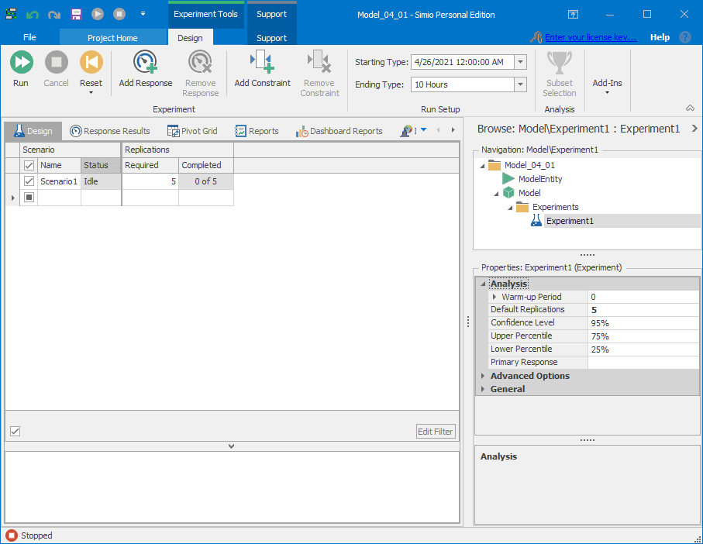
First Simio Model
Replications and statistical analyses:
  Experiment Window in Simio: helps with replications
Experiment is where you run your analysis.
Experiment has many features, but for now we will just focus on the ability to run multiple replications.
A replication is a run of the model using separate and non-overlapping random number and random variates.

Slide 23
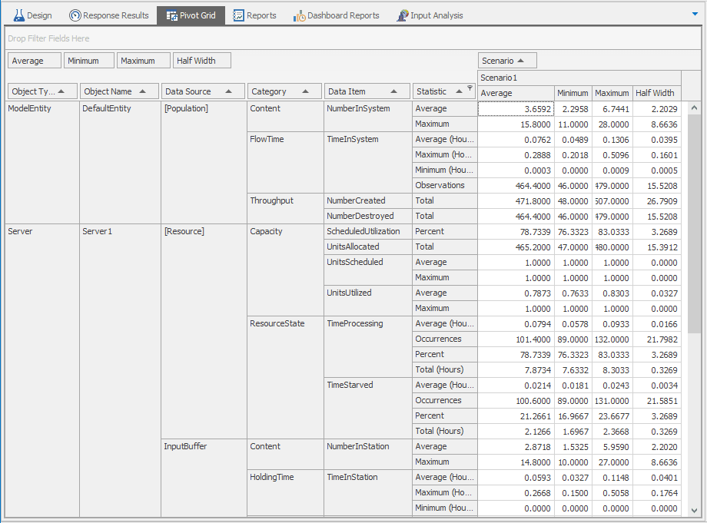
First Simio Model
Replications and statistical analyses:
  Output Results window for the experiment will be slightly different
Average of the specific output over the replications
Minimum for the specific output observed over the replications
Maximum for the specific output observed over the replications

Slide 24
First Simio Model
Replications and statistical analyses:
  Output Results window for the experiment will be slightly different
The Half-width, Average, and Confidence Level can be roughly interpreted as:
→With the specified Confidence level, I am confident that the true result is within half-width of the average.
→E.g, I am 95% confident that the true Average Number in System is within the range 3.659 +/- 2.203 or [1.456 to 5.862, a pretty wide range]

Slide 25
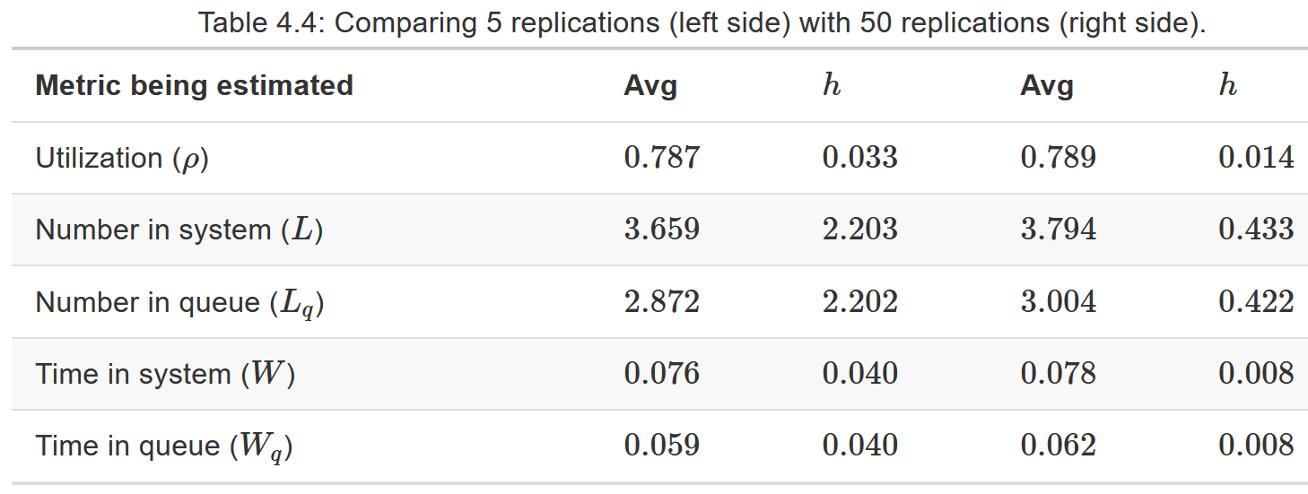
First Simio Model
Replications and statistical analyses:
  Running 5 replications provides better results, but note the large half widths.
  50 reps is still better, with much smaller half widths.
We could keep running more and more replications (and maybe we should) but there is another problem we are still overlooking – startup bias.

Slide 26
First Simio Model
Steady-State vs. Terminating Simulations
  Initial transient period – The time between the start of a run and the time when a model reaches steady state.
  Steady-state model – We are interested in the long-term steady-state performance of the model.
    Would like to ignore the initial transient period.
    Options:
      Use a warm-up period
      Initialize the model to start “close” to steady state
      Run the model long enough to dilute the initial bias caused by including data from the transient period
  Terminating model – we would like to include the initial transient period in our analysis.

Slide 27
First Simio Model
Model Verification:
  Running our original model for 500 replications of 30 hours, each with a 20 hour warm up period.
  At this point we have strong evidence that our model is verified via the comparisons with queueing theory results.
Metric | Queueing | Model
Utilization (r) | 0.800 | 0.800 ± 0.004
Number in System (L) | 4.000 | 4.001 ± 0.134
Number in Queue (L_{q}) | 3.200 | 3.201 ± 0.130
Time in System (W) | 0.083 | 0.083 ± 0.003
Time in Queue (W_{q}) | 0.067 | 0.066 ± 0.003

Slide 28
Outline
Basic Simio User Interface
First Simio Model
  Modeling : An M/M/1
  Verification: An M/M/1
A Review with an Example

Slide 29
Bank Example: Description
A model:
  Consider a walk-up bank that that has an ATM, a single teller, and a manager.
  ATM customers visit the ATM and teller customers visit the teller.
  10% of customers (regardless of original type) visit the manager after visiting the ATM or teller.
  Arrival and service time (all exponential) properties are:
    ATM customers arrive at the rate of 10/hour and spend approximately 4 minutes at the ATM
    Teller customers arrive at the rate of 5/hour and spend approximately 7 minute at the teller
    Customers that visit the manager spend approximately 20 minutes with the manager
  Run 25 replications for 2000 hours each (no warmup) and determine the server utilizations and the times that the customers spend in the system (ATM customers, teller customers, customers that see the manager)
  Verify the model as well!

Slide 30
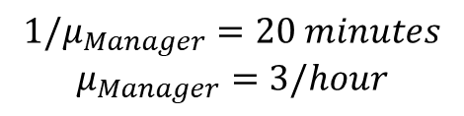

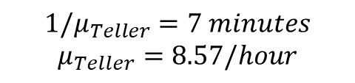
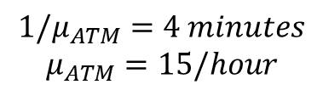


Bank Example: The Queueing Network
A model: A Jackson Network
$$λ_{ATM}=10/hour$$
ATM (M/M/1)
0.9
0.1
$${1/μ}_{ATM}=4 minutes$$
$$μ_{ATM}=15/hour$$
Manager (M/M/1)
$$λ_{Manager} =0.1λ_{ATM}+0.1λ_{Teller}$$
$$=1.5/hour$$
$${1/μ}_{Manager}=20 minutes$$
$$μ_{Manager}=3/hour$$
0.1
$$λ_{Teller}=5/hour$$
Teller (M/M/1)
0.9
$${1/μ}_{Teller}=7 minutes$$
$$μ_{Teller}=8.57/hour$$

Slide 31
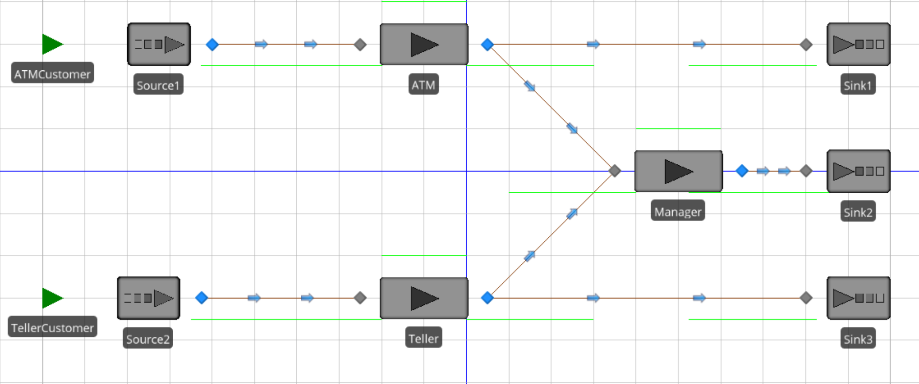
Bank Example: Simio Model
Simio model:
See ‘Bank Example.spfx’ file for the completed model.

Slide 32
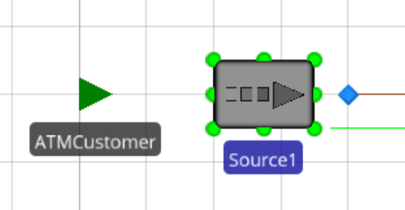
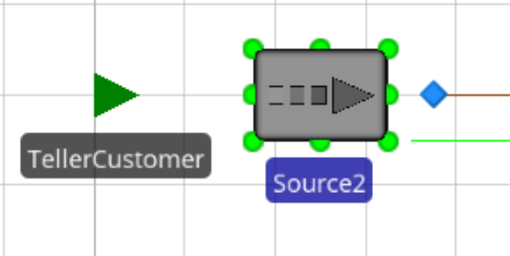
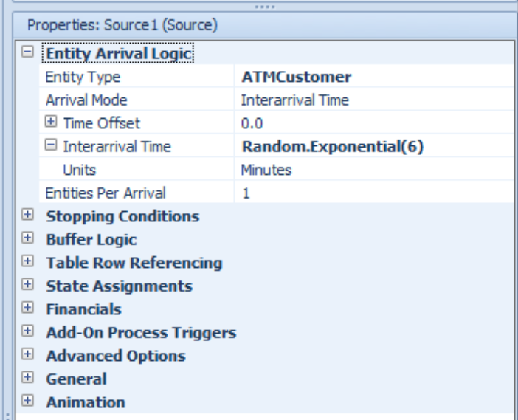
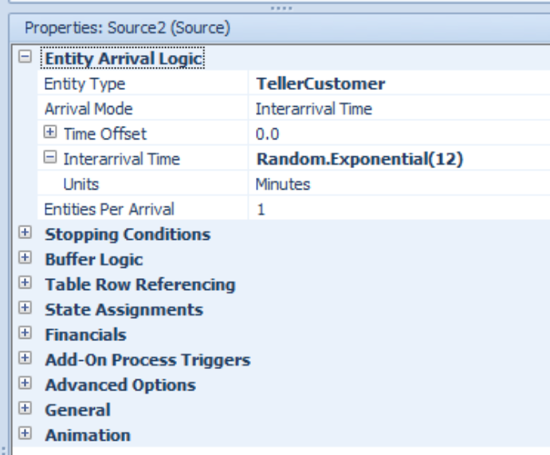
Bank Example: Simio Modeling
Simio model details:
  Associating entities with the sources

Slide 33
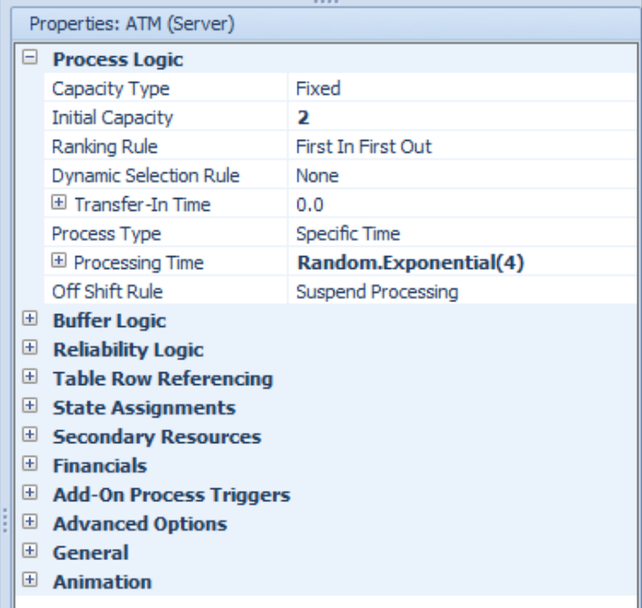
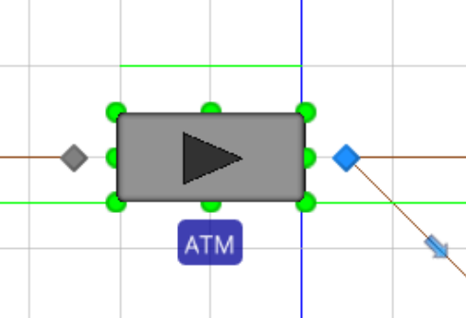
Bank Example: Simio Modeling
The Simio model:
  Suppose that there were two ATM’s at the ATM station
    That is, ATM station is M/M/2
    We would simply change the capacity of ATM server to 2

Slide 34
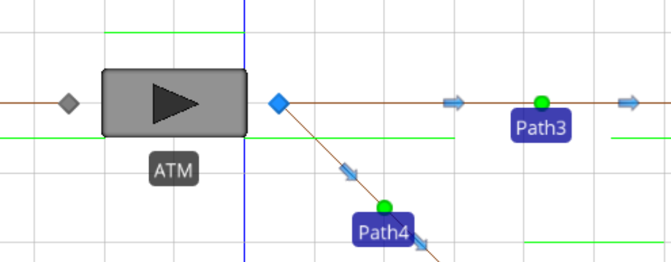
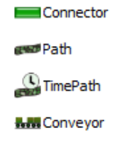
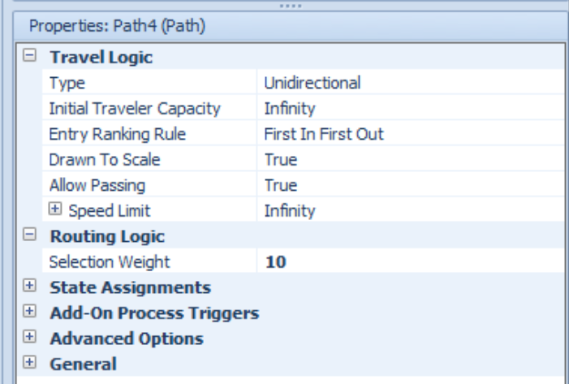

Bank Example: Simio Modeling
The Simio model:
  Selection weights
Same idea applies to the other connecting objects:
Probability of selecting a path: (weight of the path) / (total weight)
→For path 3 (going to sink 1 from ATM): probability of path 3 = 90/ (90+10) = 0.9
→For path 4 (going to sink Manager from ATM): probability of path 4 = 10/ (90+10) = 0.1

Slide 35
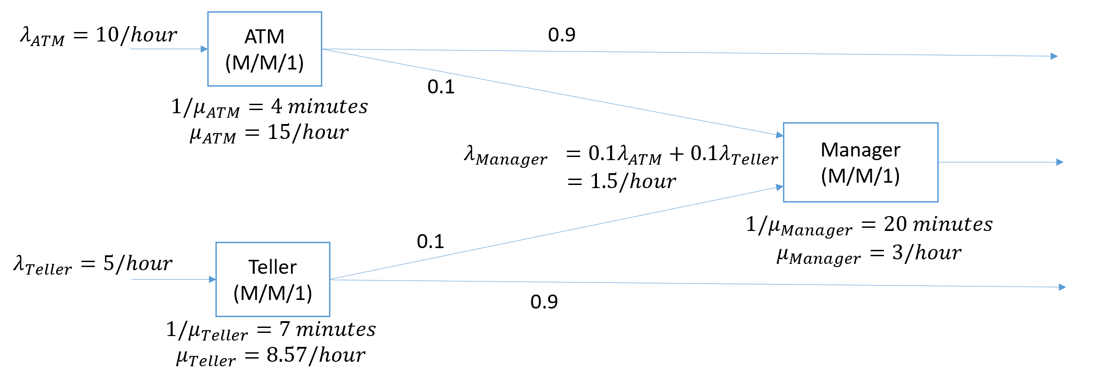
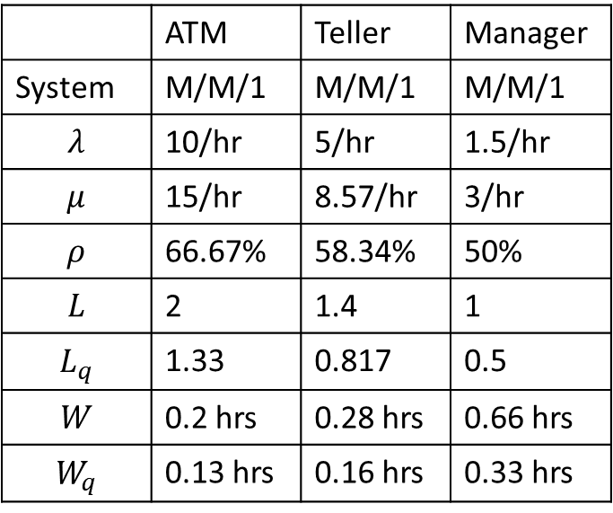
Bank Example
Model Verification:
  Queueing theory results: Jackson Network
 | ATM | Teller | Manager
System | M/M/1 | M/M/1 | M/M/1
$$λ$$ | 10/hr | 5/hr | 1.5/hr
$$μ$$ | 15/hr | 8.57/hr | 3/hr
$$ρ$$ | 66.67% | 58.34% | 50%
$$L$$ | 2 | 1.4 | 1
$$L_{q}$$ | 1.33 | 0.817 | 0.5
$$W$$ | 0.2 hrs | 0.28 hrs | 0.66 hrs
$$W_{q}$$ | 0.13 hrs | 0.16 hrs | 0.33 hrs

Slide 36
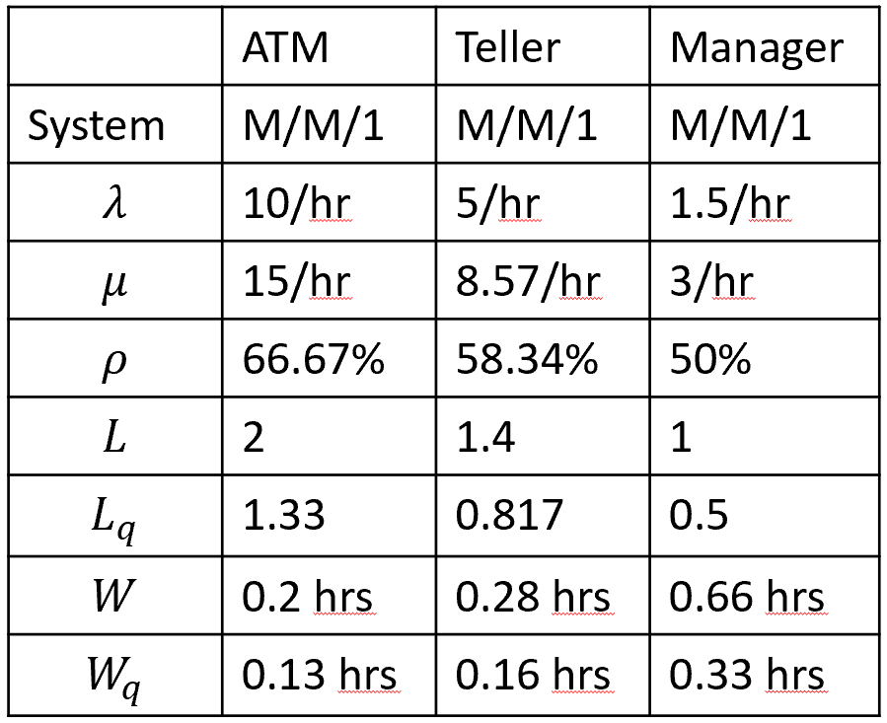
Bank Example
Model Verification:
  Queueing theory results: Jackson Network
    How much time does an ATM-customer spend in the bank on average?
      An ATM customer goes through ATM station for sure, where s/he spends 0.2 hrs avg.
      An ATM customer goes through Manager station with 0.1 probability, where s/he spends 0.66 hrs on average
      Then an ATM customer spends: 0.2hr+0.1*0.66 = 0.266 hrs in the Bank on average
        An ATM customer who does not go to Manager spends 0.2 hrs on average
        An ATM customer who goes to Manager spends 0.2+0.66 = 0.86 hrs on average
    How much time does a Teller-customer spend in the bank on average?
      A Teller customer goes through Teller station for sure, where s/he spends 0.28 hrs on average
      A Teller customer goes through Manager station with 0.1 probability, where s/he spends 0.66 hrs on average
      Then a Teller customer spends: 0.28hr+0.1*0.66 = 0.346 hrs in the Bank on average
        A Teller customer who does not go to Manager spends 0.28 hrs on average
        A Teller customer who goes to Manager spends 0.28+0.66 = 0.94 hrs on average

Slide 37
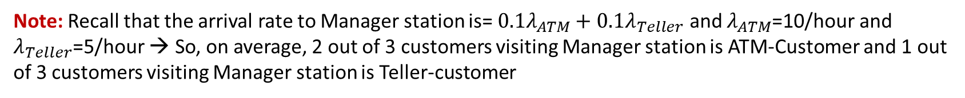
Bank Example
Model Verification:
  Queueing theory results: Jackson Network
    How many ATM-customers are in the bank on average?
      There are 2 customers in ATM station on average, and they are all ATM-customers
      There are 1 customer in Manager station on average
        2/3 of them are ATM-customers and 1/3 are Teller-customers
      So, in total, there are 2+1*2/3=2.667 ATM-customers in the bank on average
    How many Teller-customers are in the bank on average?
      There are 1.4 customers in Teller station on average, and they are all Teller-customers
      There are 1 customer in Manager station on average
        2/3 of them are ATM-customers and 1/3 are Teller-customers
      So, in total, there are 1.4+1*1/3=1.734 Teller-customers in the bank on average
Note: Recall that the arrival rate to Manager station is= $0.1λ_{ATM}+0.1λ_{Teller}$ and $λ_{ATM}$=10/hour and $λ_{Teller}$=5/hour → So, on average, 2 out of 3 customers visiting Manager station is ATM-Customer and 1 out of 3 customers visiting Manager station is Teller-customer

Slide 38
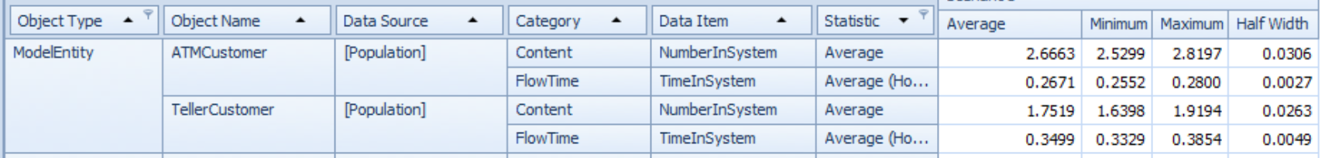
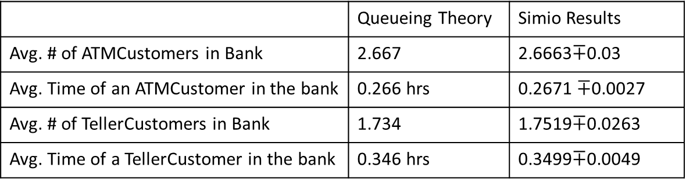
Bank Example
Model Verification:
  Simio Results: 25 replications, each with 2000 hours and no warm-up
 | Queueing Theory | Simio Results
Avg. # of ATMCustomers in Bank | 2.667 | 2.6663$∓$0.03
Avg. Time of an ATMCustomer in the bank | 0.266 hrs | 0.2671 $∓$0.0027
Avg. # of TellerCustomers in Bank | 1.734 | 1.7519$∓$0.0263
Avg. Time of a TellerCustomer in the bank | 0.346 hrs | 0.3499$∓$0.0049
Not Bad!!

Slide 39
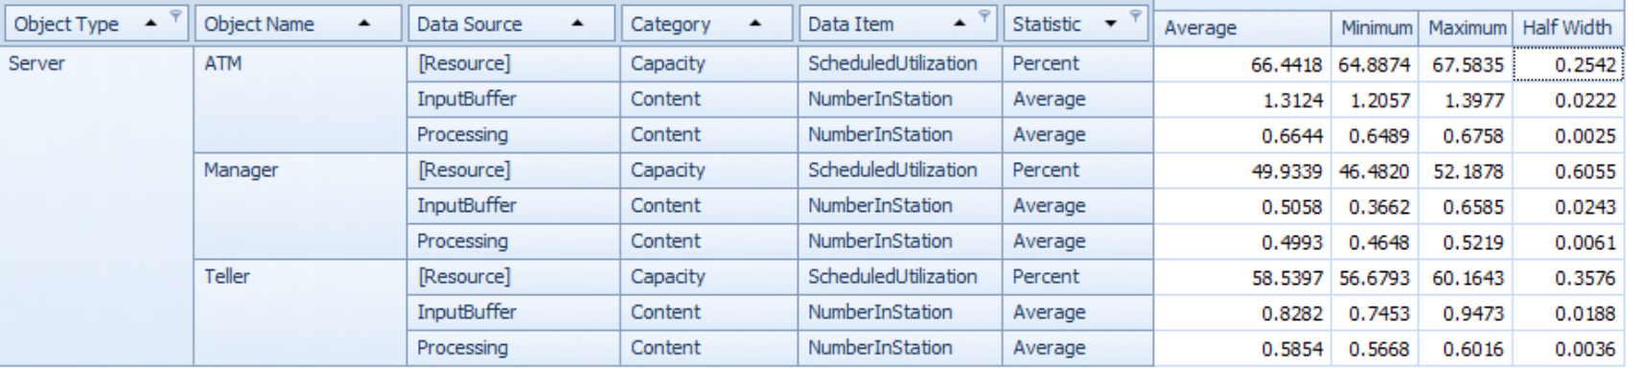

Bank Example
Model Verification:
  Queueing theory results: Jackson Network
    Server utilizations and number of customers at the stations
      ATM: $ρ=66.67\%, Lq=1.33, L=2$
      Teller: $ρ=58.34\%, Lq=0.817, L=1.4$
      Manager: $ρ=50\%, Lq=0.5, L=1$
  Simio results:
Not Bad!!

Slide 40
Bank Example
Model Verification:
  Queueing theory results: Jackson Network
    The avg. time spent by a customer exiting from different paths (sinks 1, 2, 3)
      Sink 1: These are the customers who exit after visiting ATM → W=0.2 hrs
      Sink 3: These are the customers who exit after visiting Teller → W=0.28 hrs
      Sink 2: These are the customers who exit after visiting Manager
        They spend W=0.66 hrs in the Manager station on average
        Before coming to the Manager station
          A customer comes from ATM station with probability 2/3
          A customer comes from Teller station with probability 1/3
          So before coming to Manager, expected time spent is 2/3*0.2+1/3*0.28
        So customers who exit after visiting Manager spend 0.66+ 2/3*0.2+1/3*0.28=0.886 hrs on average
  Simio results:
Not Bad!!

